Slide 1
Email Classifier using python
Machine Learing project

Slide 2

B.TECH 2022-2026 4th SEMESTER LEARNING PROJECT
Submitted by SUMAN KUMAR RANA, SURYA PRAKASH, MOHILESH MADAN PATRO Roll No- 22CSE730, 22CSE848, 22CSE851
Under the Guidance of Asst. Prof. Ms.Iteshree Panda

Slide 3

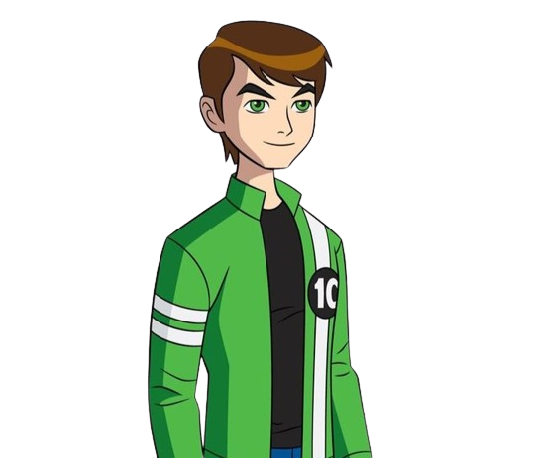

Team Members
SUMAN KUMAR RANA 22CSE730
MOHILESH MADAN PATRA
22CSE851
SURYA PRAKASH
22CSE848

Slide 4
TABLE OF CONTENTS
Data collection
Data cleaning
EDA
Text preprocessing
Model building

Slide 5
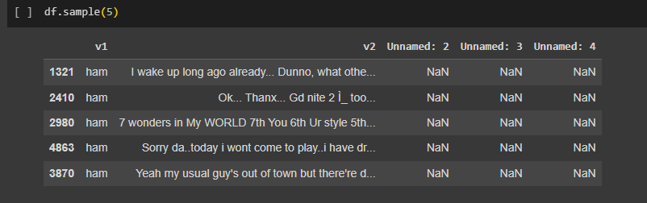
Data collection
Sample data

Slide 6
Data cleaning
-Checking for the less non null value columns and removing them
-Renaming our remaining columns to more understandable form
-Using label encoder to change our target column’s data as (Ham=0,Spam=1)
-Checking for null values and then removing them
-Checking for duplicate values and then removing them

Slide 7
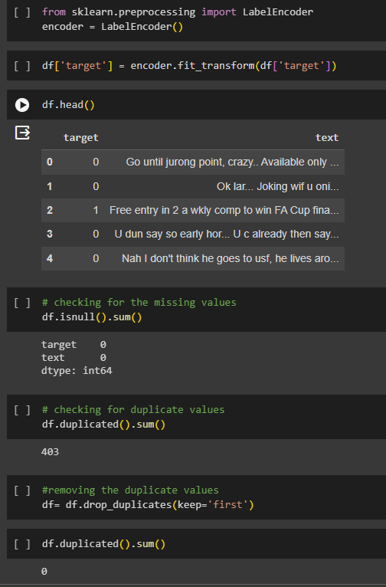

Slide 8
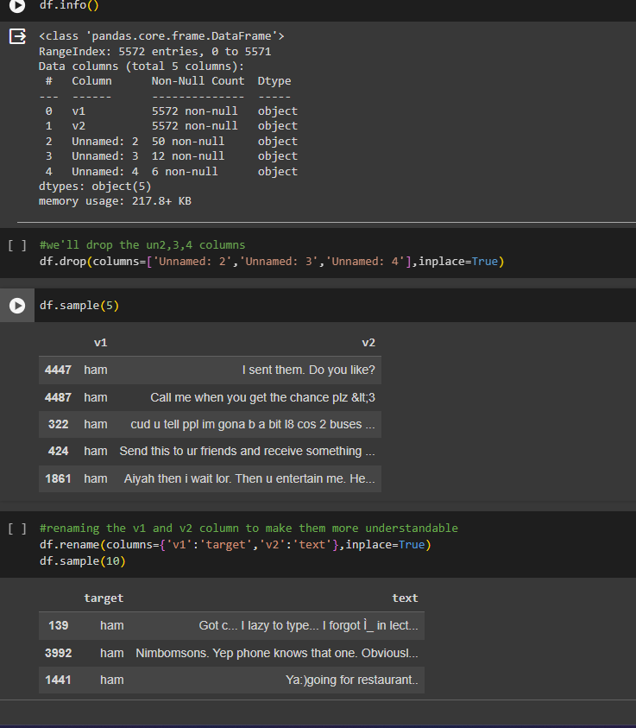

Slide 9
Exploratory Data Analysis
-Checking the number of ham and pam mail in our dataset
-Calculating the number of characters present in our text column of the dataset
-Calculating the number of words present in our text column of the dataset
-Calculating the number of sentences present in our text column of the dataset
-Calculating the number of characters, words, sentences present in ham and spam data
-visualizing above calculation in graphs

Slide 10
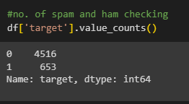
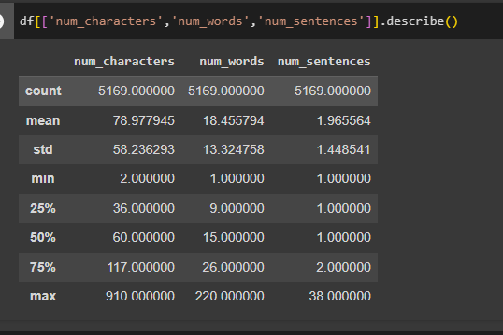
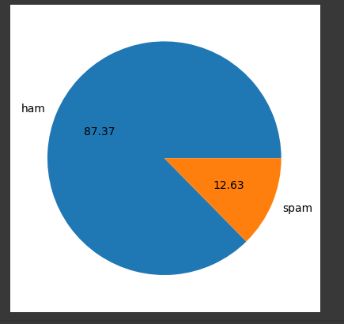

Slide 11
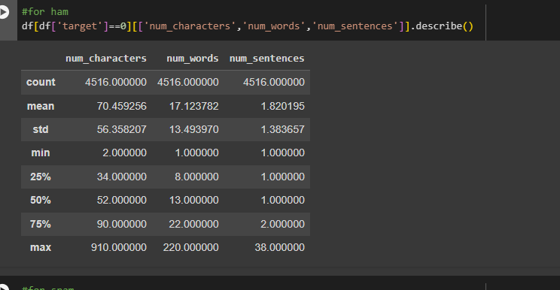
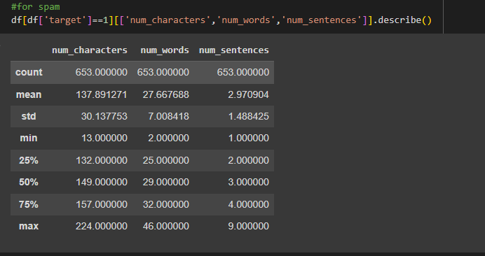

Slide 12
Data preprocessing
-Using transform_text function we’ll transform the input mail
-converting all the characters to lower case then checking for the alphanumeric
-Removing the stopwords and punctuation from the data
-stemming the text
-At the end appending all our text in new dataframe
-Using word cloud for finding the most used words in the dataframe
-calculating the most used words in the ham and spam mails

Slide 13
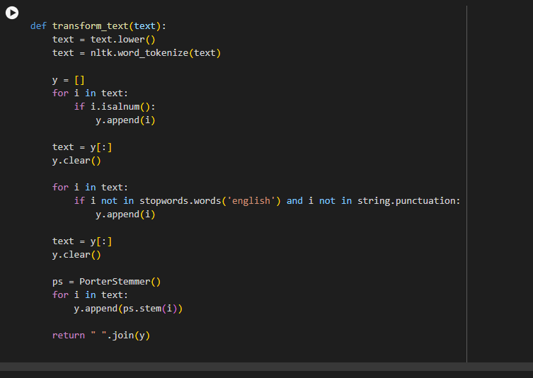

Slide 14
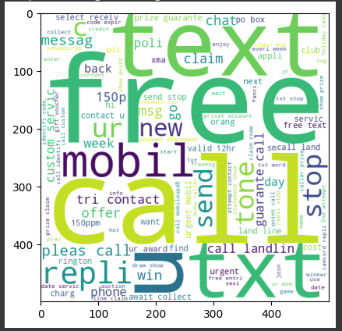
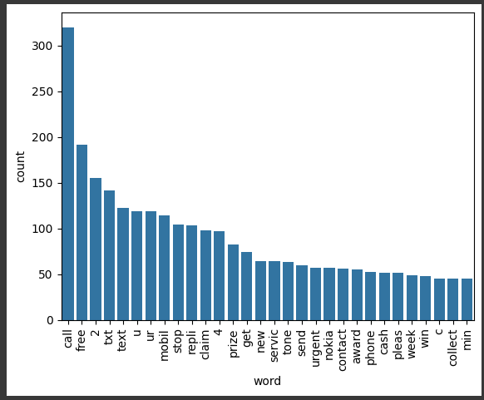

Slide 15
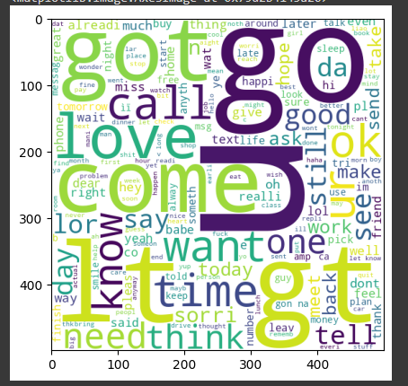
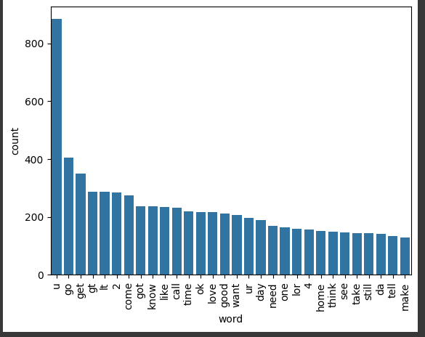

Slide 16
Model Building
-Using Naive based algorithm, as it performs well on textual data
-Using TidfVectorizer to convert the data into numeric form
-Using train_test_split for splitting the data into training data and testing data
-Using different Naïve based techiques line GaussianNB, MultinomialNB, BernoulliNB
-Using different ML algorithms Logistic Regression, SVC, KNeighborsClassifier, RandomForestClassifier, AdaBoostClassifier, BaggingClassifier, ExtraTreesClassifier, GradientBoostingClassifier, XGBClassifier
-Calculating accuracy and precision of each techniques
-Model improving
-Using voting classifier to select the best technique
-Using pickle , to pickle the victorizer and model pkl file and create the pipeline

Slide 17
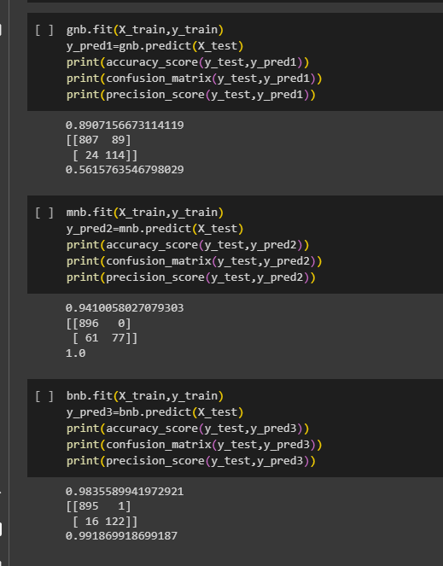

Slide 18
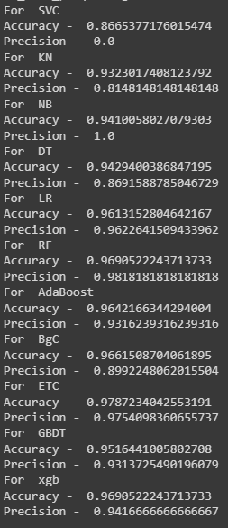
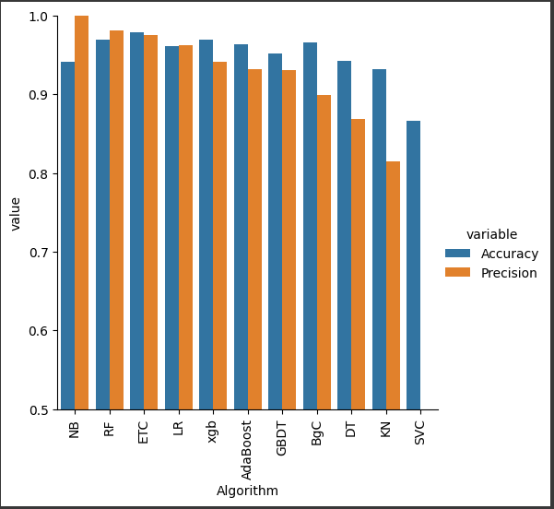

Slide 19
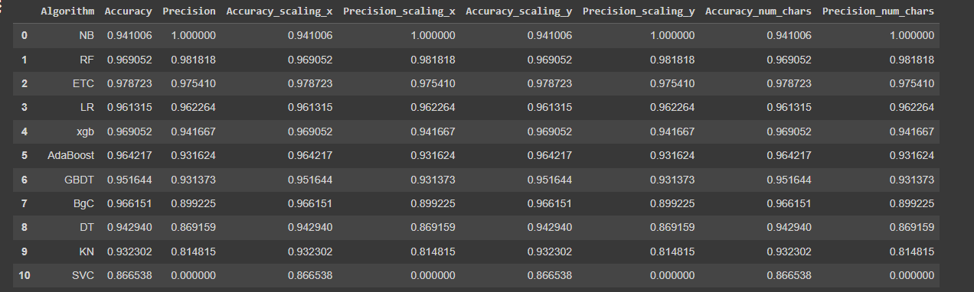

Slide 20

THANKS!

Slide 22
TABLE OF CONTENTS
01
04
About the Project
Sneak Peek
02
05
Major Requirements
Project Stages
03
06
Project Goals
Our Team
Here you could describe
the topic of the section
Here you could describe
the topic of the section
Here you could describe
the topic of the section
Here you could describe
the topic of the section
Here you could describe
the topic of the section
Here you could describe
the topic of the section

Slide 23
Data cleaning
-Checking for the less non null value columns and removing them

Slide 24
—SOMEONE FAMOUS
“This is a quote. Words full of wisdom that someone important said and can make the reader get inspired.”

Slide 25
OUR TIMELINE
WEEK 1
WEEK 3
BETA
RELEASE
FINAL
VERSION
WEEK 2
WEEK 4
Improvements
Increased traffic
Focus group
Progress review

Slide 26
CREDITS
This is where you give credit to the ones who are part of this project.
Presentation template by Slidesgo
Icons by Flaticon
Infographics by Freepik
Images created by Freepik
Author introduction slide photo created by Freepik
Text & Image slide photo created by Freepik

Slide 27
Use our editable graphic resources...
You can easily resize these resources without losing quality. To change the color, just ungroup the resource and click on the object you want to change. Then, click on the paint bucket and select the color you want. Group the resource again when you’re done. You can also look for more infographics on Slidesgo.

Slide 30
JANUARY
FEBRUARY
MARCH
APRIL
MAY
JUNE
PHASE 1
Task 1
Task 2
PHASE 2
Task 1
Task 2
JANUARY
FEBRUARY
MARCH
APRIL
PHASE 1
Task 1
Task 2

Slide 33
...and our sets of editable icons
You can resize these icons without losing quality.
You can change the stroke and fill color; just select the icon and click on the paint bucket/pen.
In Google Slides, you can also use Flaticon’s extension, allowing you to customize and add even more icons.

Slide 34
Educational Icons
Medical Icons

Slide 35
Business Icons
Teamwork Icons

Slide 36
Help & Support Icons
Avatar Icons

Slide 37
Creative Process Icons
Performing Arts Icons

Slide 38
Nature Icons

Slide 39
SEO & Marketing Icons

